Slide 1
E-BIKES
KNOW THE LAW:
ARE YOU RIDING YOUR
E-BIKE LEGALLY?

Slide 2

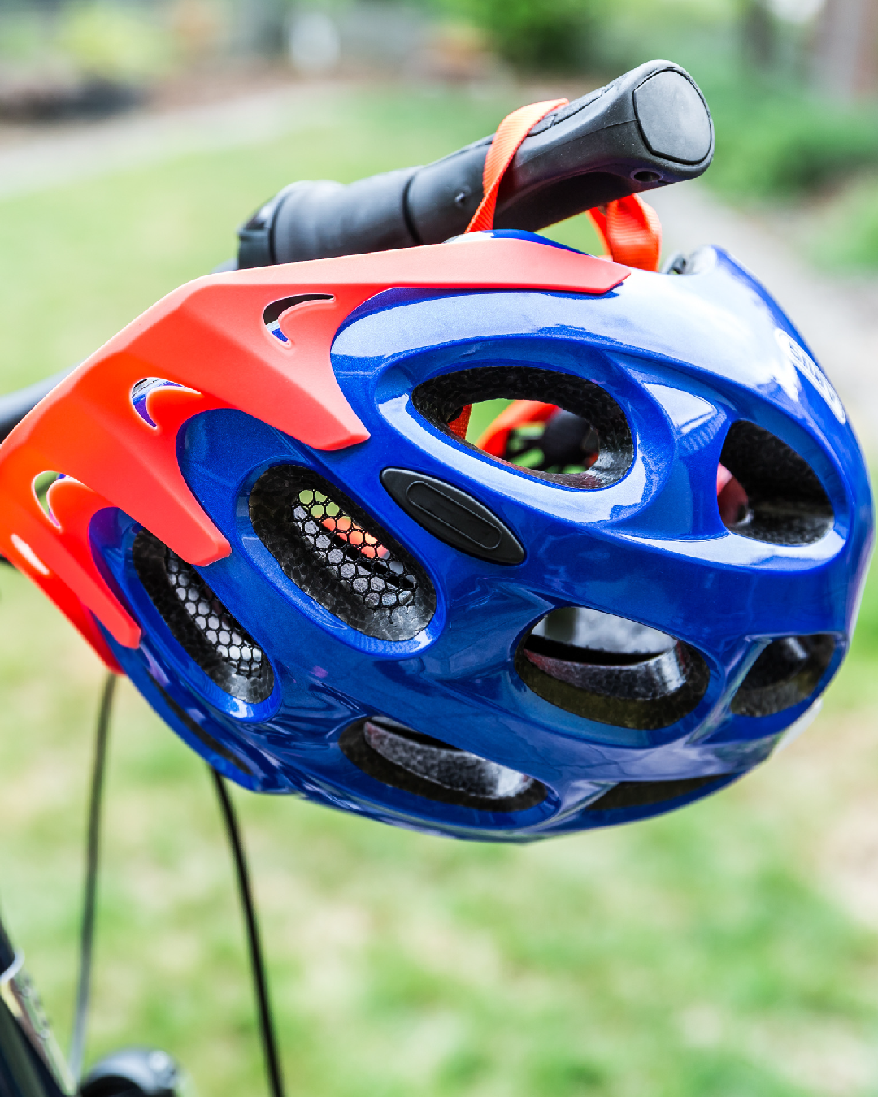

CALIFORNIA ASSEMBLY BILL 1096 (2015)
Riders must follow all traffic laws, including stop signs, signals, and lane rules.
All riders of Class 1, 2, and 3 e-bikes under age 18 must wear a helmet.

Slide 3
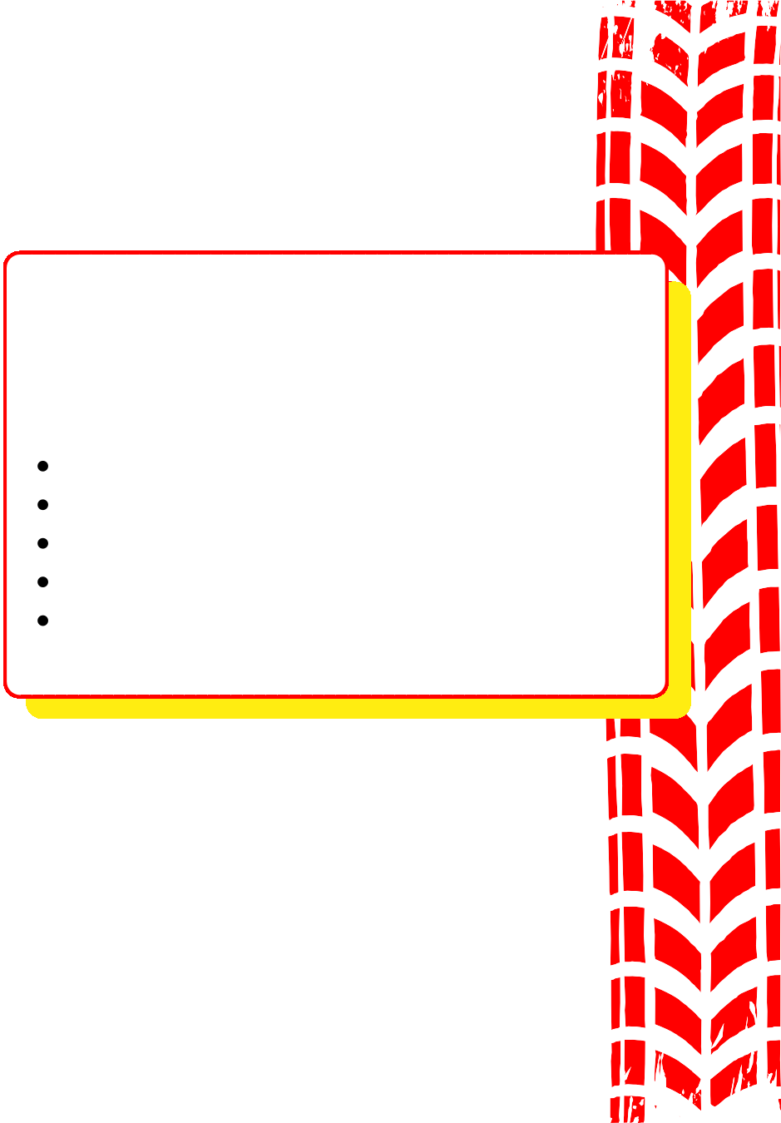
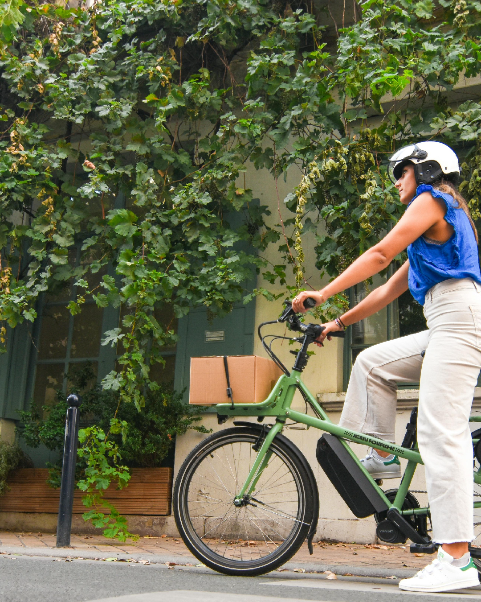
CLASS 1 E-BIKE
Pedal-assist only Max speed: 20 mph
Can be used on most bike paths No age restriction
Helmet required if under 18

Slide 4

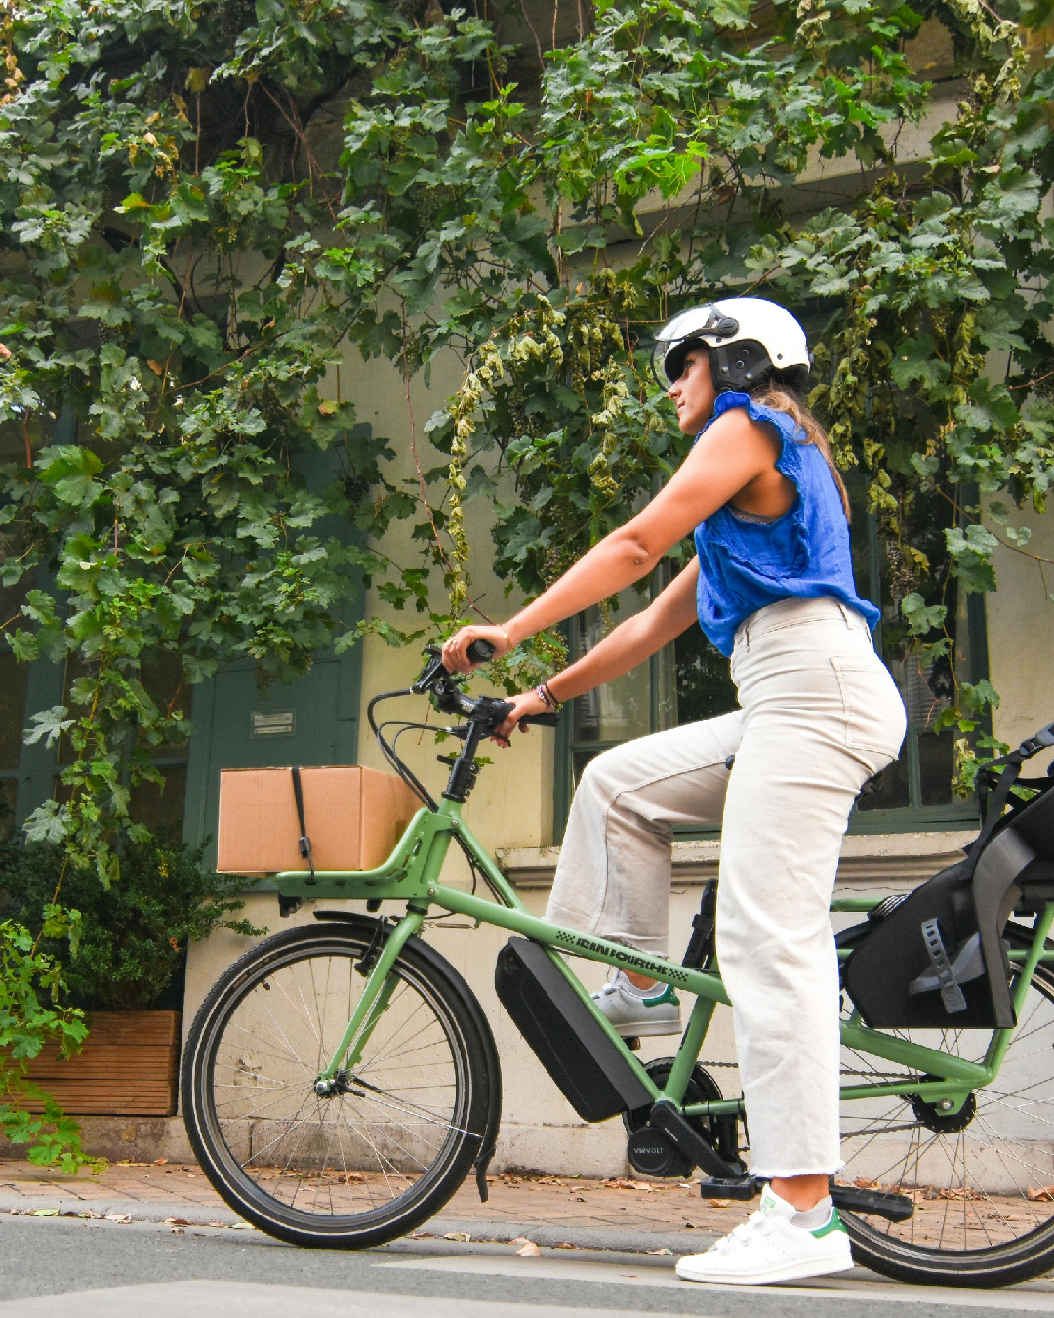
CLASS 2 E-BIKE
Throttle-assisted (no pedaling needed)
Max speed: 20 mph
Can be used on bike paths unless restricted locally
No age restriction
Helmet required if under 18

Slide 5

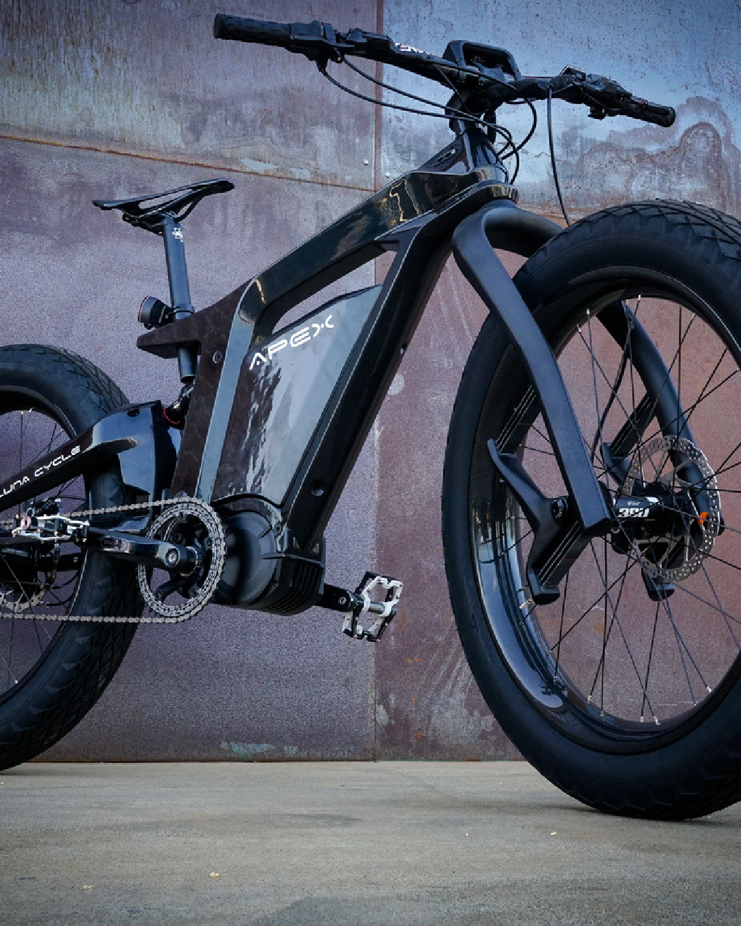
CLASS 3 E-BIKE
Pedal-assist only Max speed: 28 mph
Not allowed on bike paths Minimum rider age: 16 Helmet required for all riders

Slide 6
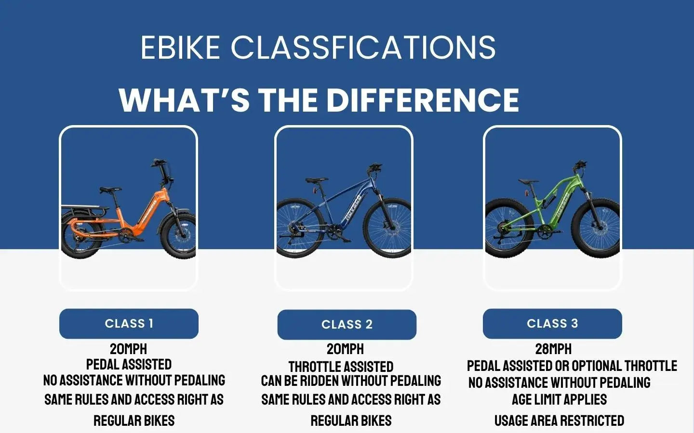

Slide 7

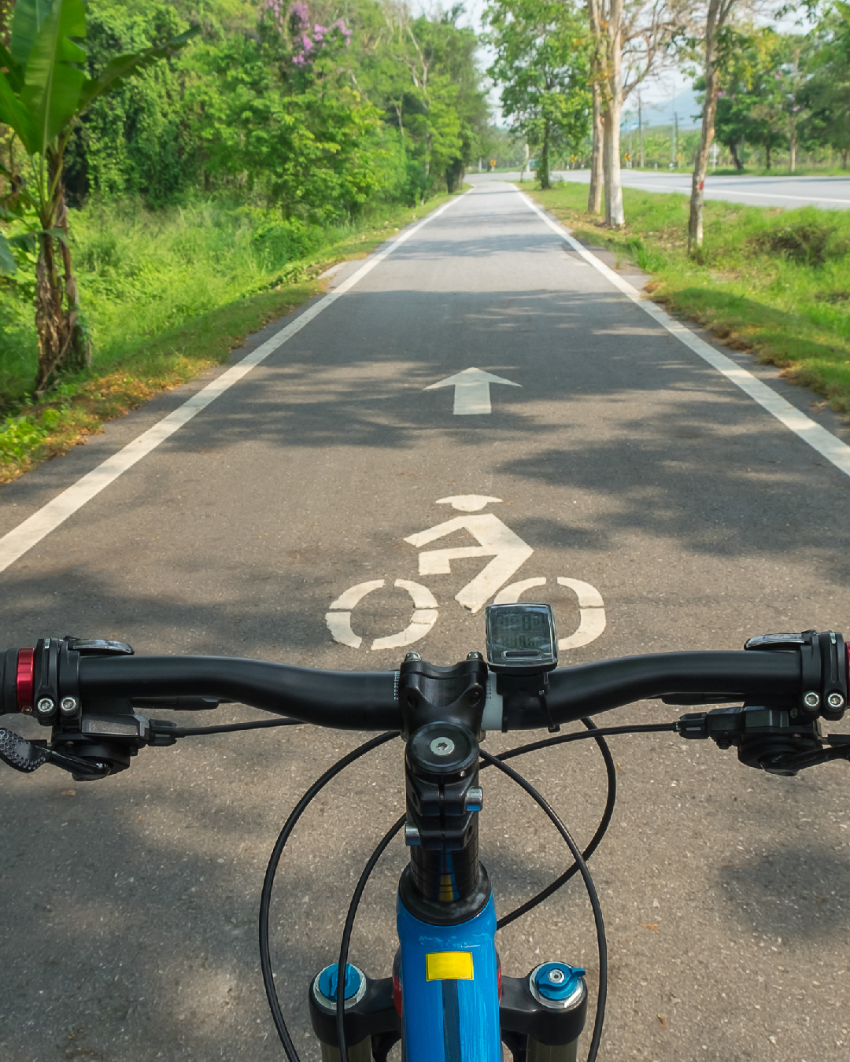
COMMON VIOLATIONS
❌ Riding e-bikes without a helmet
❌ Underage riders on Class 3 e-bikes
❌ Speeding through stop signs, stunts, reckless riding
❌ Riding on sidewalks when prohibited
❌No helmets
❌No parent supervision
❌Not knowing C.V.C. laws

Slide 8
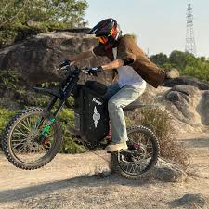
ELECTRONIC MOTORCYCLES
Not designed with pedals from the manufacturer
Over 750 watts and/or capable of traveling over 28 m.p.h.
Prohibited operation anywhere in the city per F.M.C. 14-804 (off-road design)
If ridden on any roadway must comply with all lighting, registration, and licensing requirements set forth in the C.V.C.
Subject to impound per C.V.C. 22651(o) if not properly registered

Slide 9

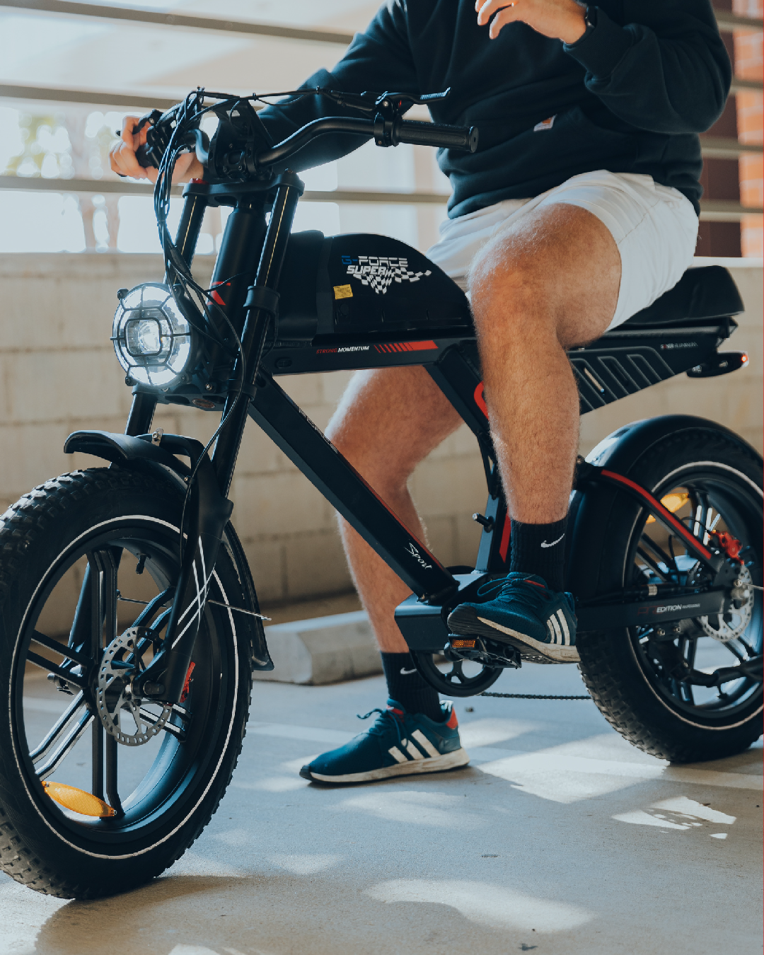
SAFETY STARTS AT HOME
✅ Talk to children about the rules of the road
✅ Make sure e-bikes are age-
appropriate and compliant
✅ Always require a helmet
✅ Supervise younger riders or restrict them to safe riding areas
Parents are responsible for helping children ride safely and legally

Slide 10
QUESTIONS?

